Slide 1
Understanding LSTM Networks
with Colah’s figures
Sungjoon Choi
Colah’s blog: http://colah.github.io/posts/2015-08-Understanding-LSTMs/

Slide 2
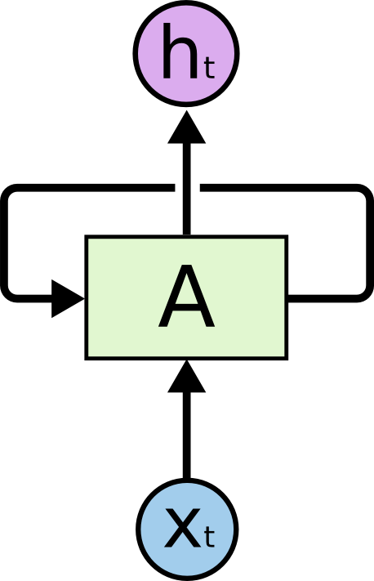
Recurrent Neural Network
http://colah.github.io/posts/2015-08-Understanding-LSTMs/

Slide 3

Recurrent Neural Network
http://colah.github.io/posts/2015-08-Understanding-LSTMs/

Slide 4
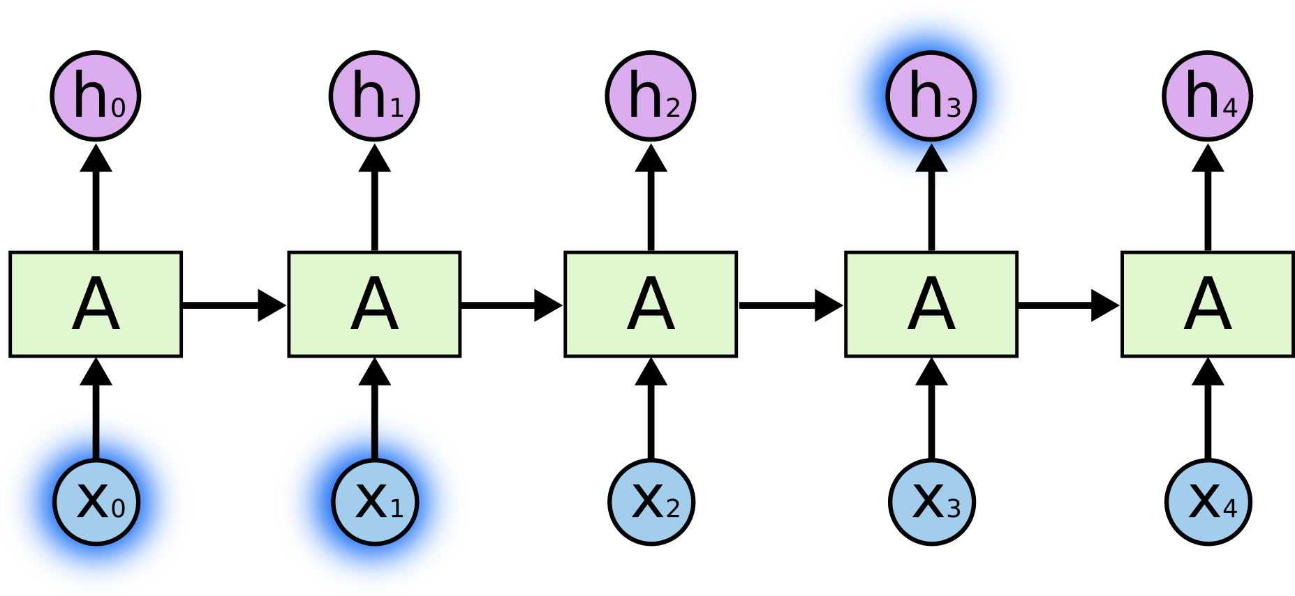
Long-Term Dependencies
The clouds are in the sky
http://colah.github.io/posts/2015-08-Understanding-LSTMs/

Slide 5
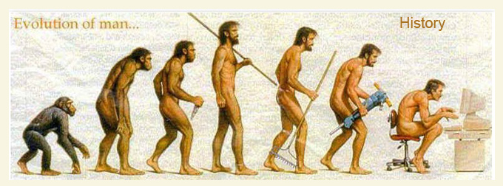
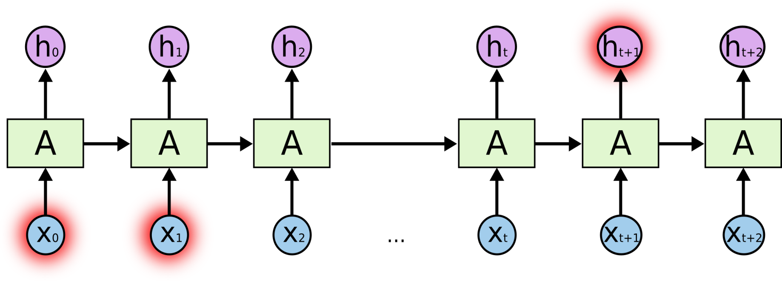
Longer-Term Dependencies
http://colah.github.io/posts/2015-08-Understanding-LSTMs/

Slide 6
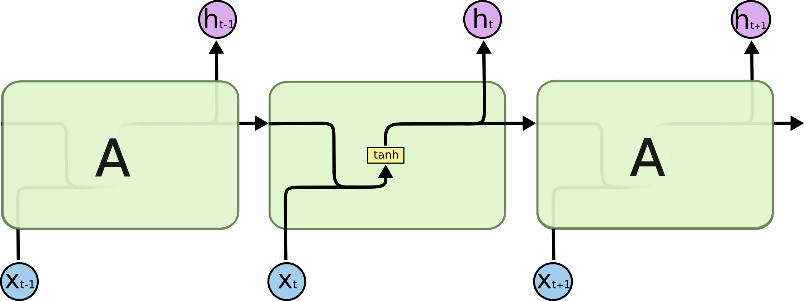
LSTM comes in!
Long Short Term Memory
This is just a standard RNN.
http://colah.github.io/posts/2015-08-Understanding-LSTMs/

Slide 7

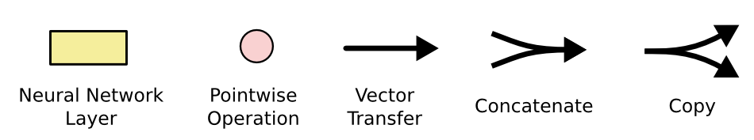
LSTM comes in!
Long Short Term Memory
This is just a standard RNN.
This is the LSTM!
http://colah.github.io/posts/2015-08-Understanding-LSTMs/

Slide 8
Overall Architecture
Output
Input Gate
(Cell) state
Next (Cell) State
Forget Gate
Output Gate
Hidden State
Next Hidden State
Input
http://colah.github.io/posts/2015-08-Understanding-LSTMs/

Slide 9
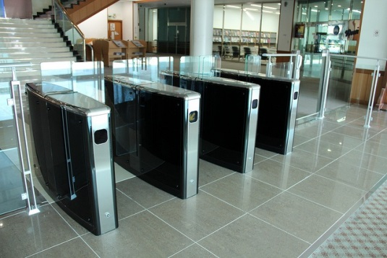

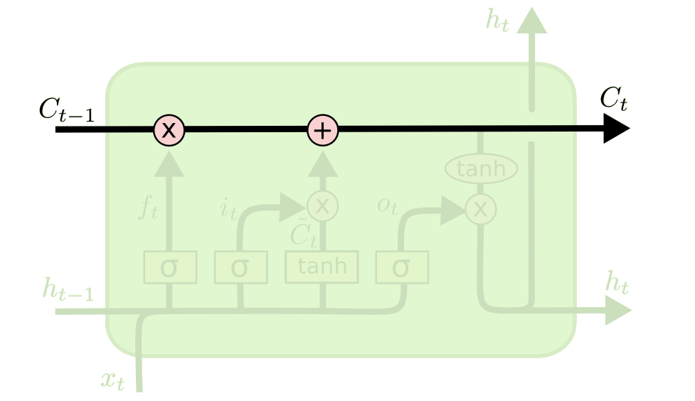
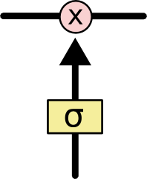
The Core Idea
http://colah.github.io/posts/2015-08-Understanding-LSTMs/

Slide 10
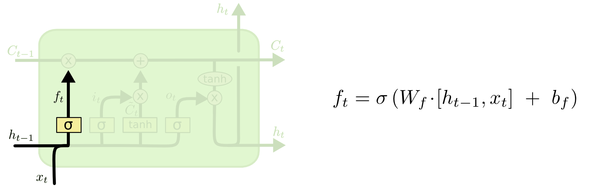
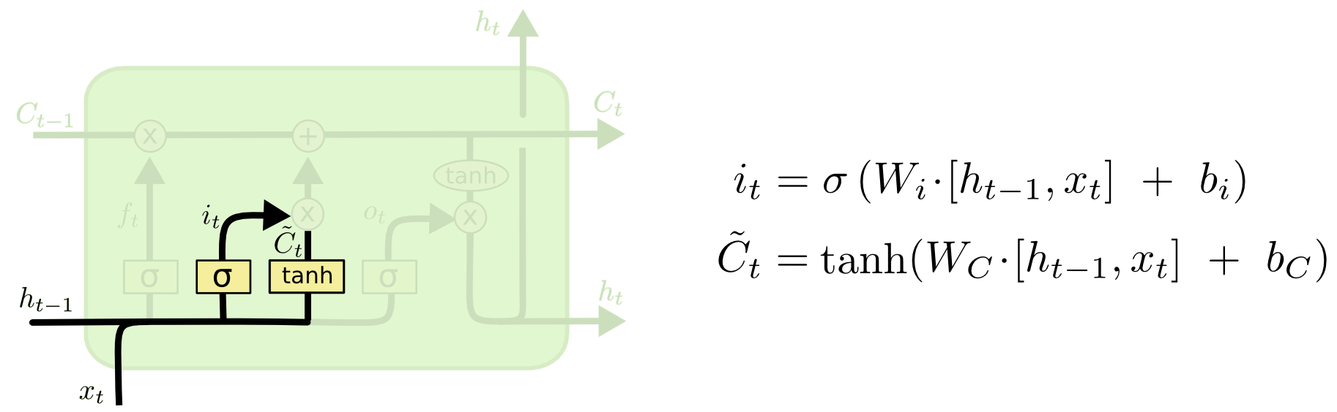
Step-by-Step
Input Gate
Decide what information we’re going to throw away from the cell state.
Forget Gate
Decide what new information we’re going to store in the cell state.
http://colah.github.io/posts/2015-08-Understanding-LSTMs/

Slide 11
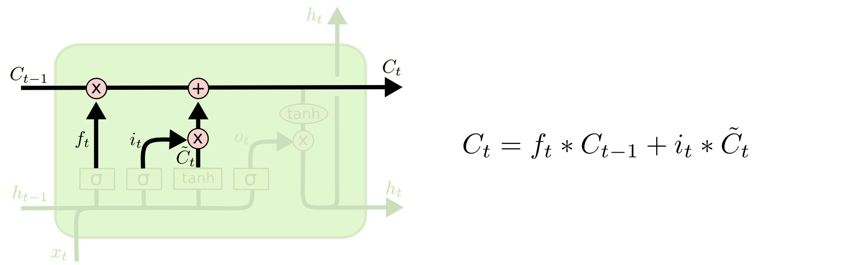
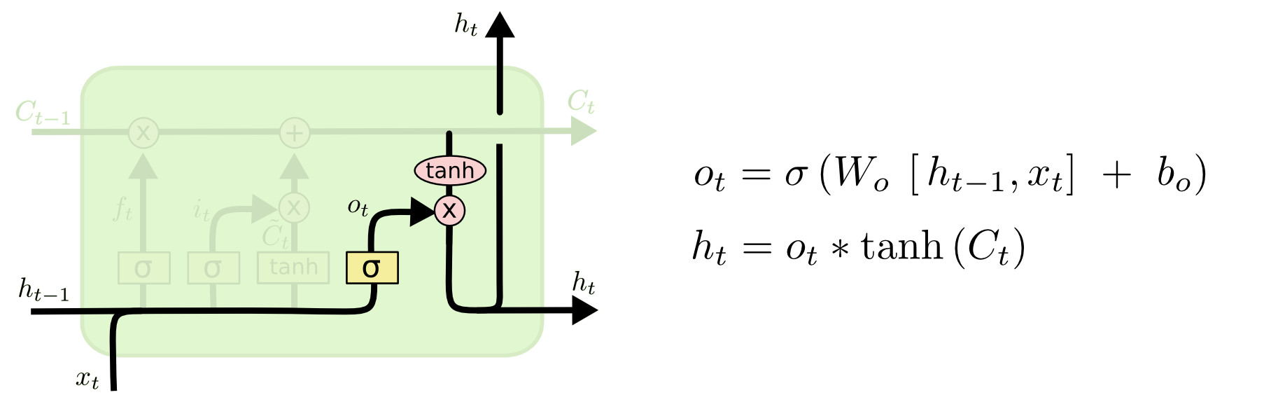
Step-by-Step
Update (cell state)
Update, scaled by how much we decide to update
: input_gate*curr_state + forget_gate*prev_state
Output Gate (hidden state)
Output based on the updated state
: output_gate*updated_state
http://colah.github.io/posts/2015-08-Understanding-LSTMs/

Slide 12
Again
Output
Input Gate
(Cell) state
Next (Cell) State
Forget Gate
Output Gate
Hidden State
Next Hidden State
Input
http://colah.github.io/posts/2015-08-Understanding-LSTMs/

Slide 13
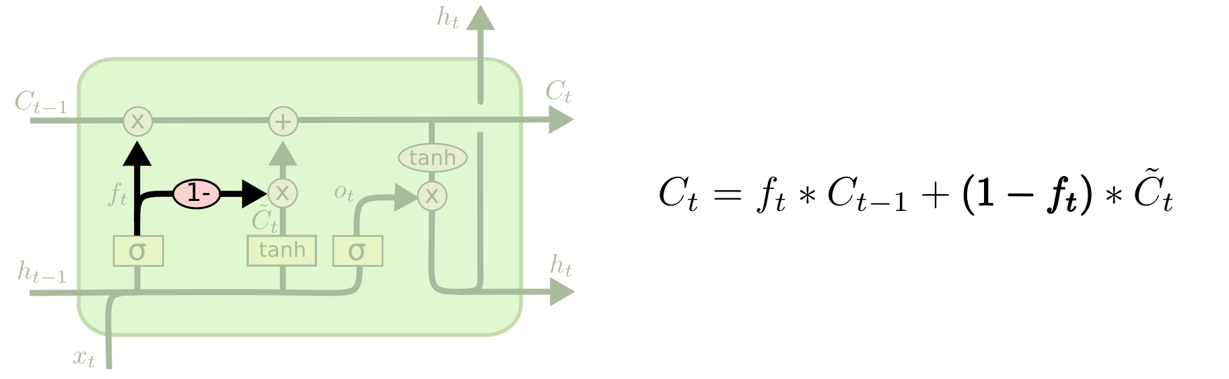
Gated Recurrent Unit
Cho, Kyunghyun, et al. "Learning phrase representations using RNN encoder-decoder for statistical machine translation." arXiv preprint arXiv:1406.1078 (2014).
http://colah.github.io/posts/2015-08-Understanding-LSTMs/

Slide 14
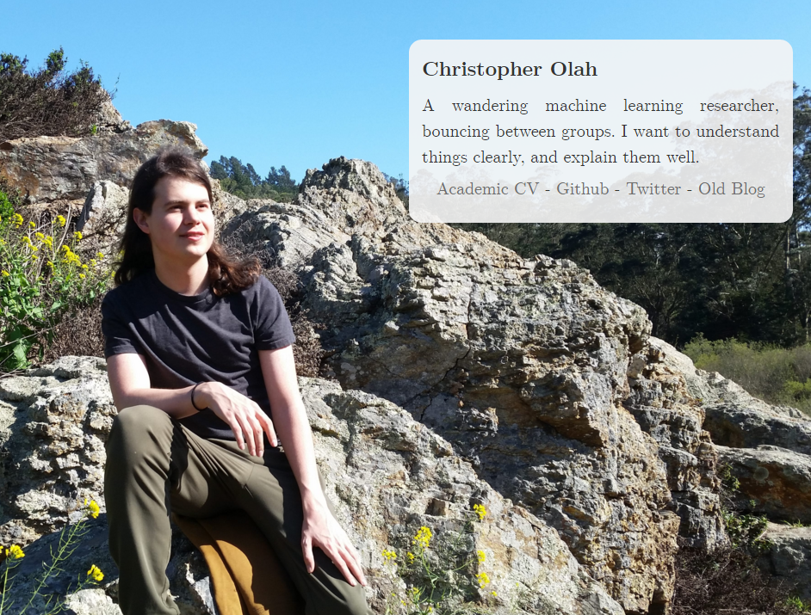
Conclusion
Thank You! You did a great work.

